Slide 1

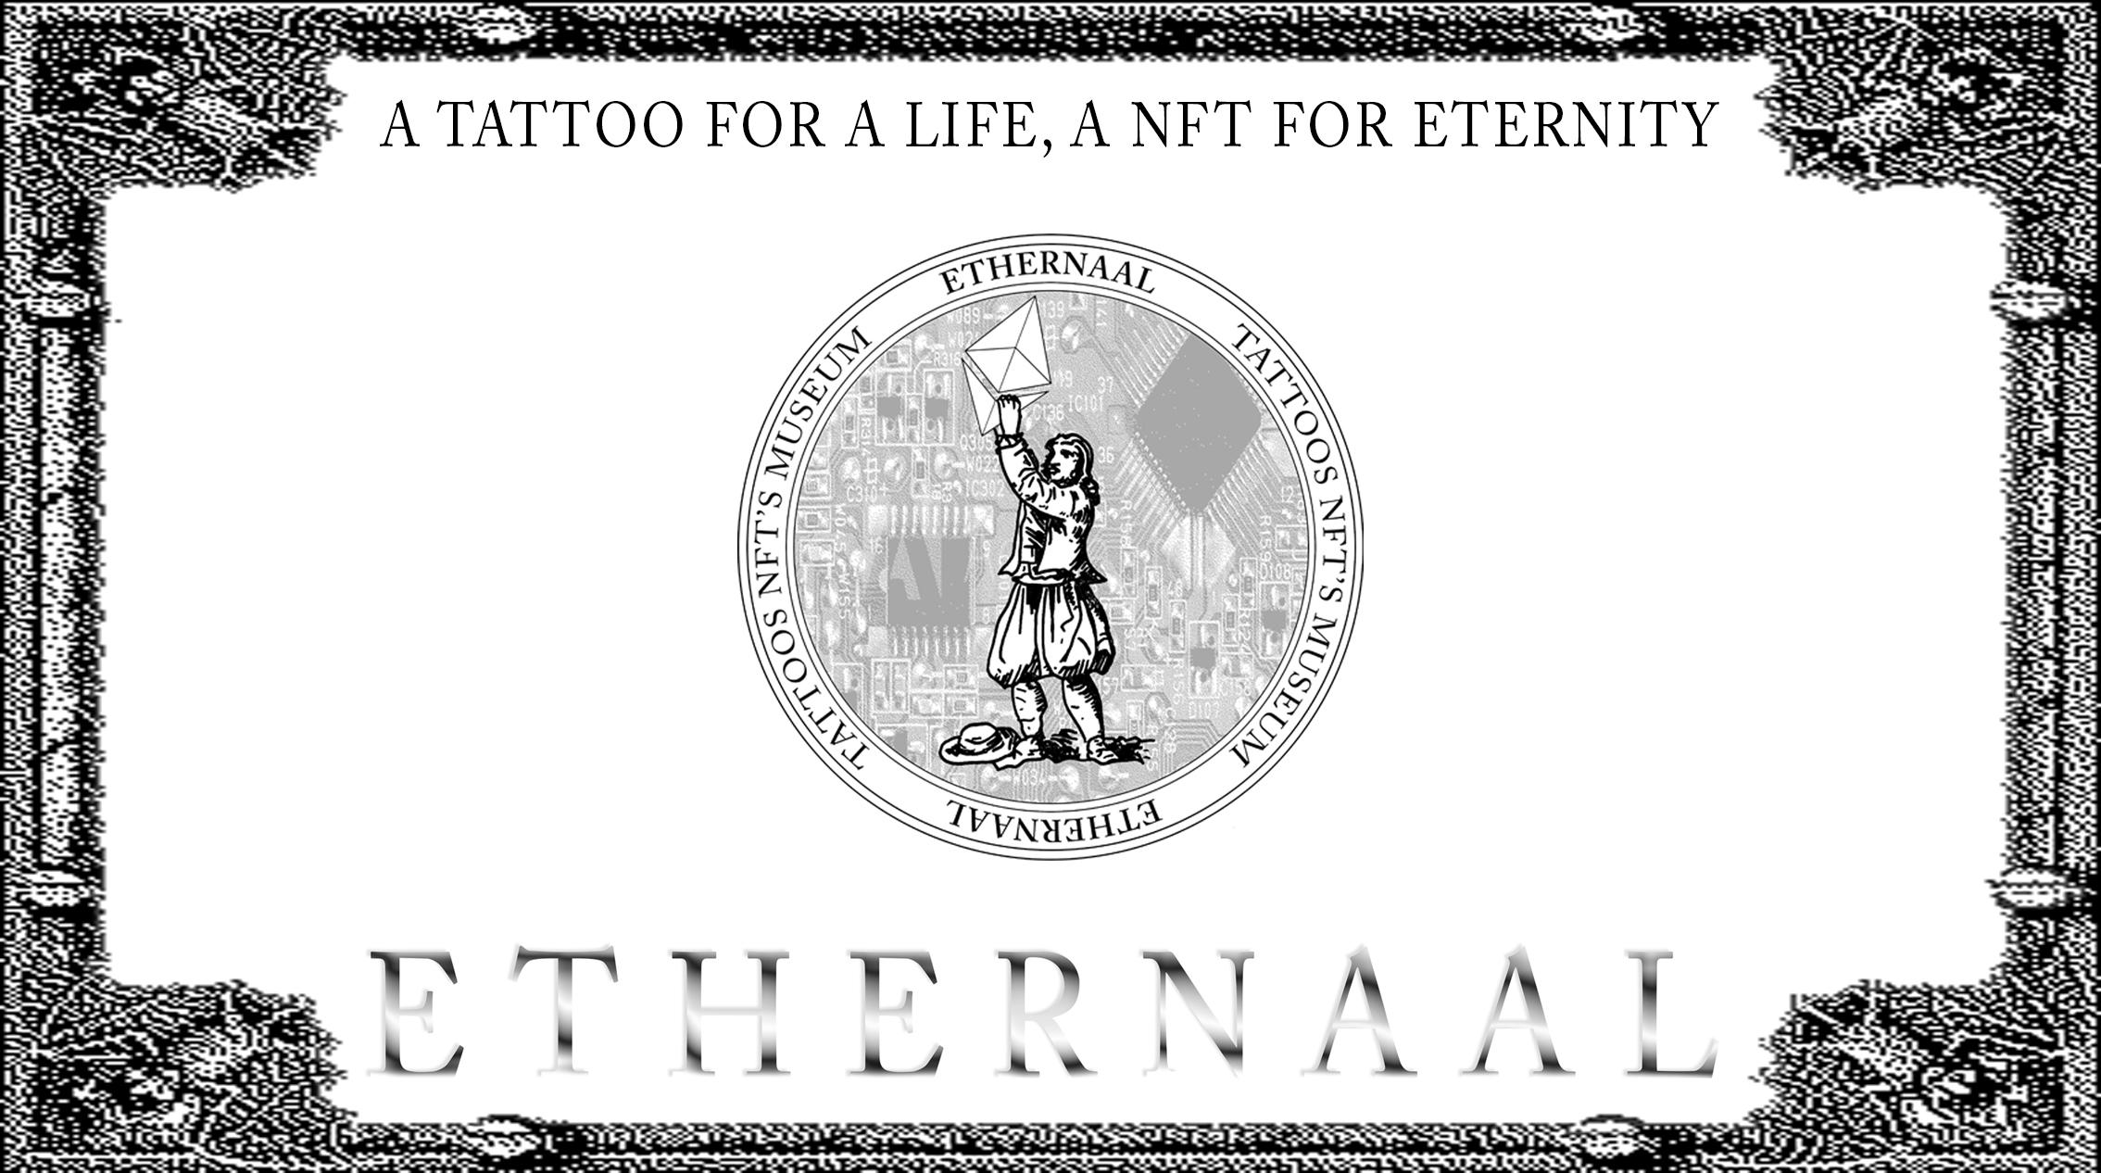
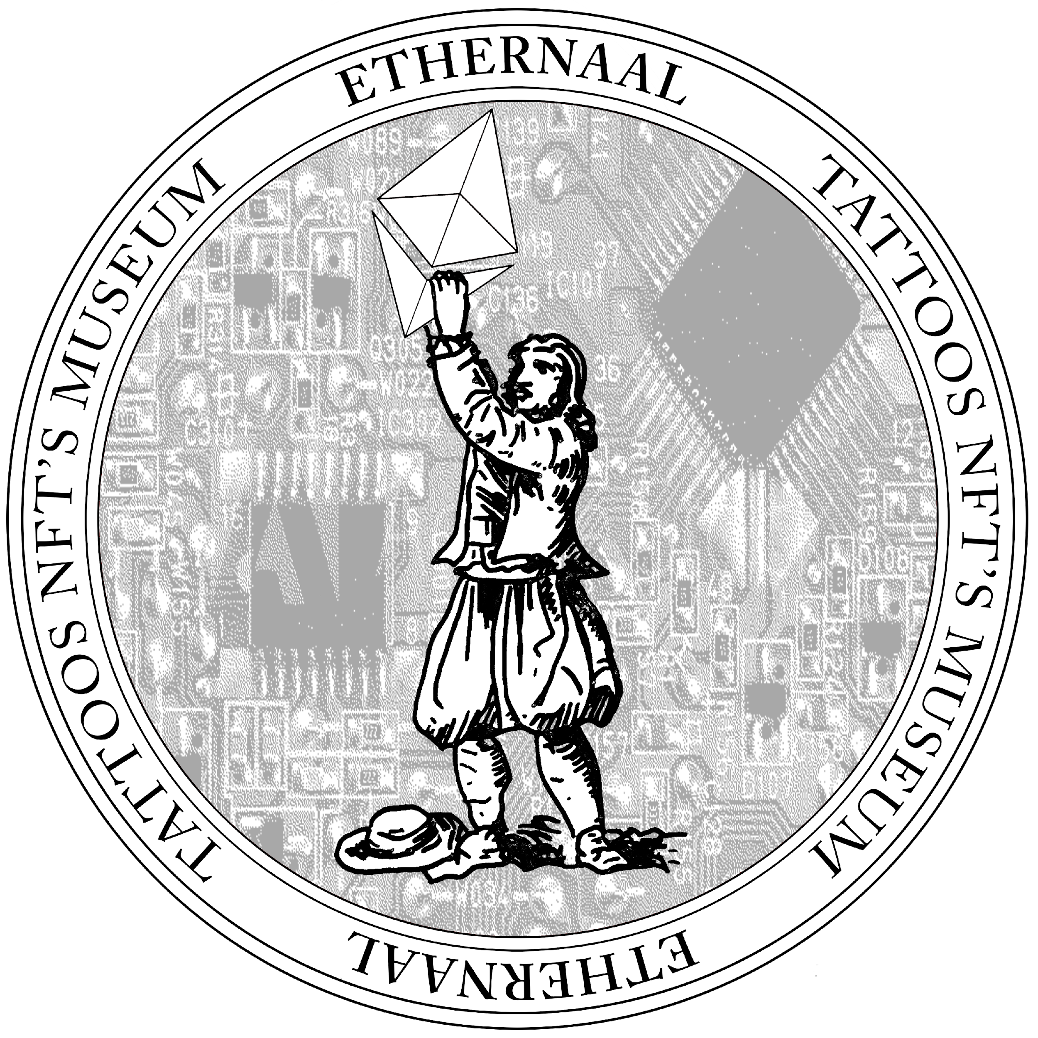
GlobalETH Hackathon Project.
Objectives: Deliver a maximum of integration and content.
Network:
Rinkeby

Slide 2
The Tattoo Artists:
Toni Brutal
Tom Ribot
Belen
London
London
London
Tattoo artist since 2016, Toni specialized himself in medieval and old figure linework.
Portfolio:
Instagram: @toni_Brutal
Tattoo artist since 2019, his discipline of predilections are abstract flash and freehand.
Portfolio:
Instagram: @drimdvst
Tattoo artist since 2019, she crafted her skills in fine line artworks.
Portfolio:
Instagram: @five.kilo.cat
Ethernaal.com

Slide 3
Ethernaal team:
Gyan
Rishabh
JM
Bassitup
Paulisson
Back end Dev
Blockchain Engineer
Front End Dev
Head of Product
Blockchain Strategist
Responsible for middleware and backend. Accessing the Rarible contracts, setting up Pinata IPFS and minting on Mintbase.
Other projects:
- github.com/gyan0890
- BeNeFiT(Charitable NFT Marketplace)
-linkedin.com/in/gyan-lakshmi
Responsible for the middleware and back end integration and tokenization of tattoo designs using the ERC721 & ERC1155 standards
Other projects: - Blockchain engineer @ DeFiner.org
- github.com/Rishabh42
Responsible for front end and back-end integration between ethernaal and the various decentralized components of the platform.
Other projects:
- Cto (Universal Voucher)
-LiskRide
-DisperseTau
In charge of design, wordpress creation, artist effort management and team coordination.
Other projects:
- Korus (korus.network)
In charge of the design and implementation of the DeFi architecture and the DAO governance.
Other projects:
- CivicPower.io
- Korus.network
- linkedin.com/in/jptz
Ethernaal.com

Slide 4
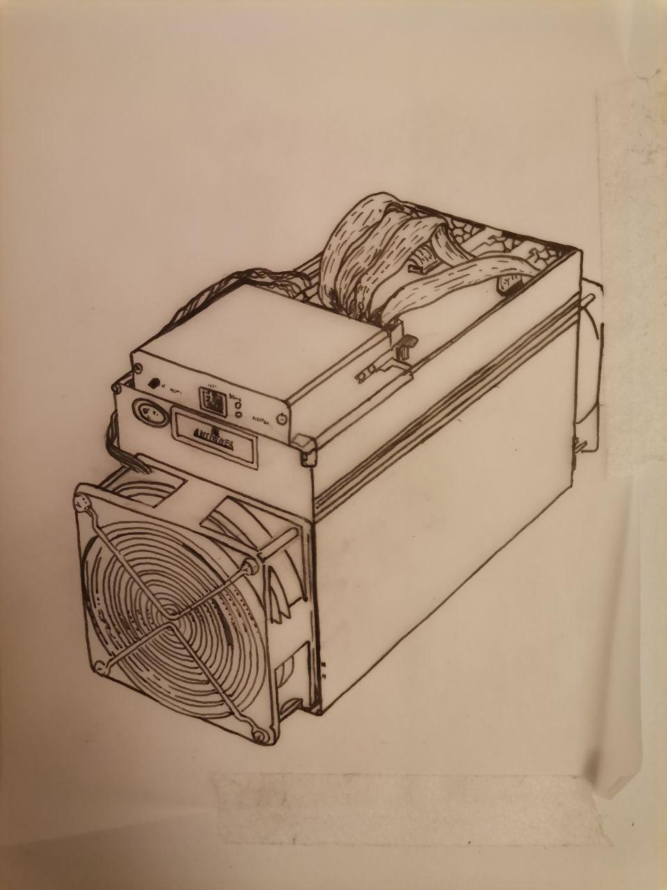
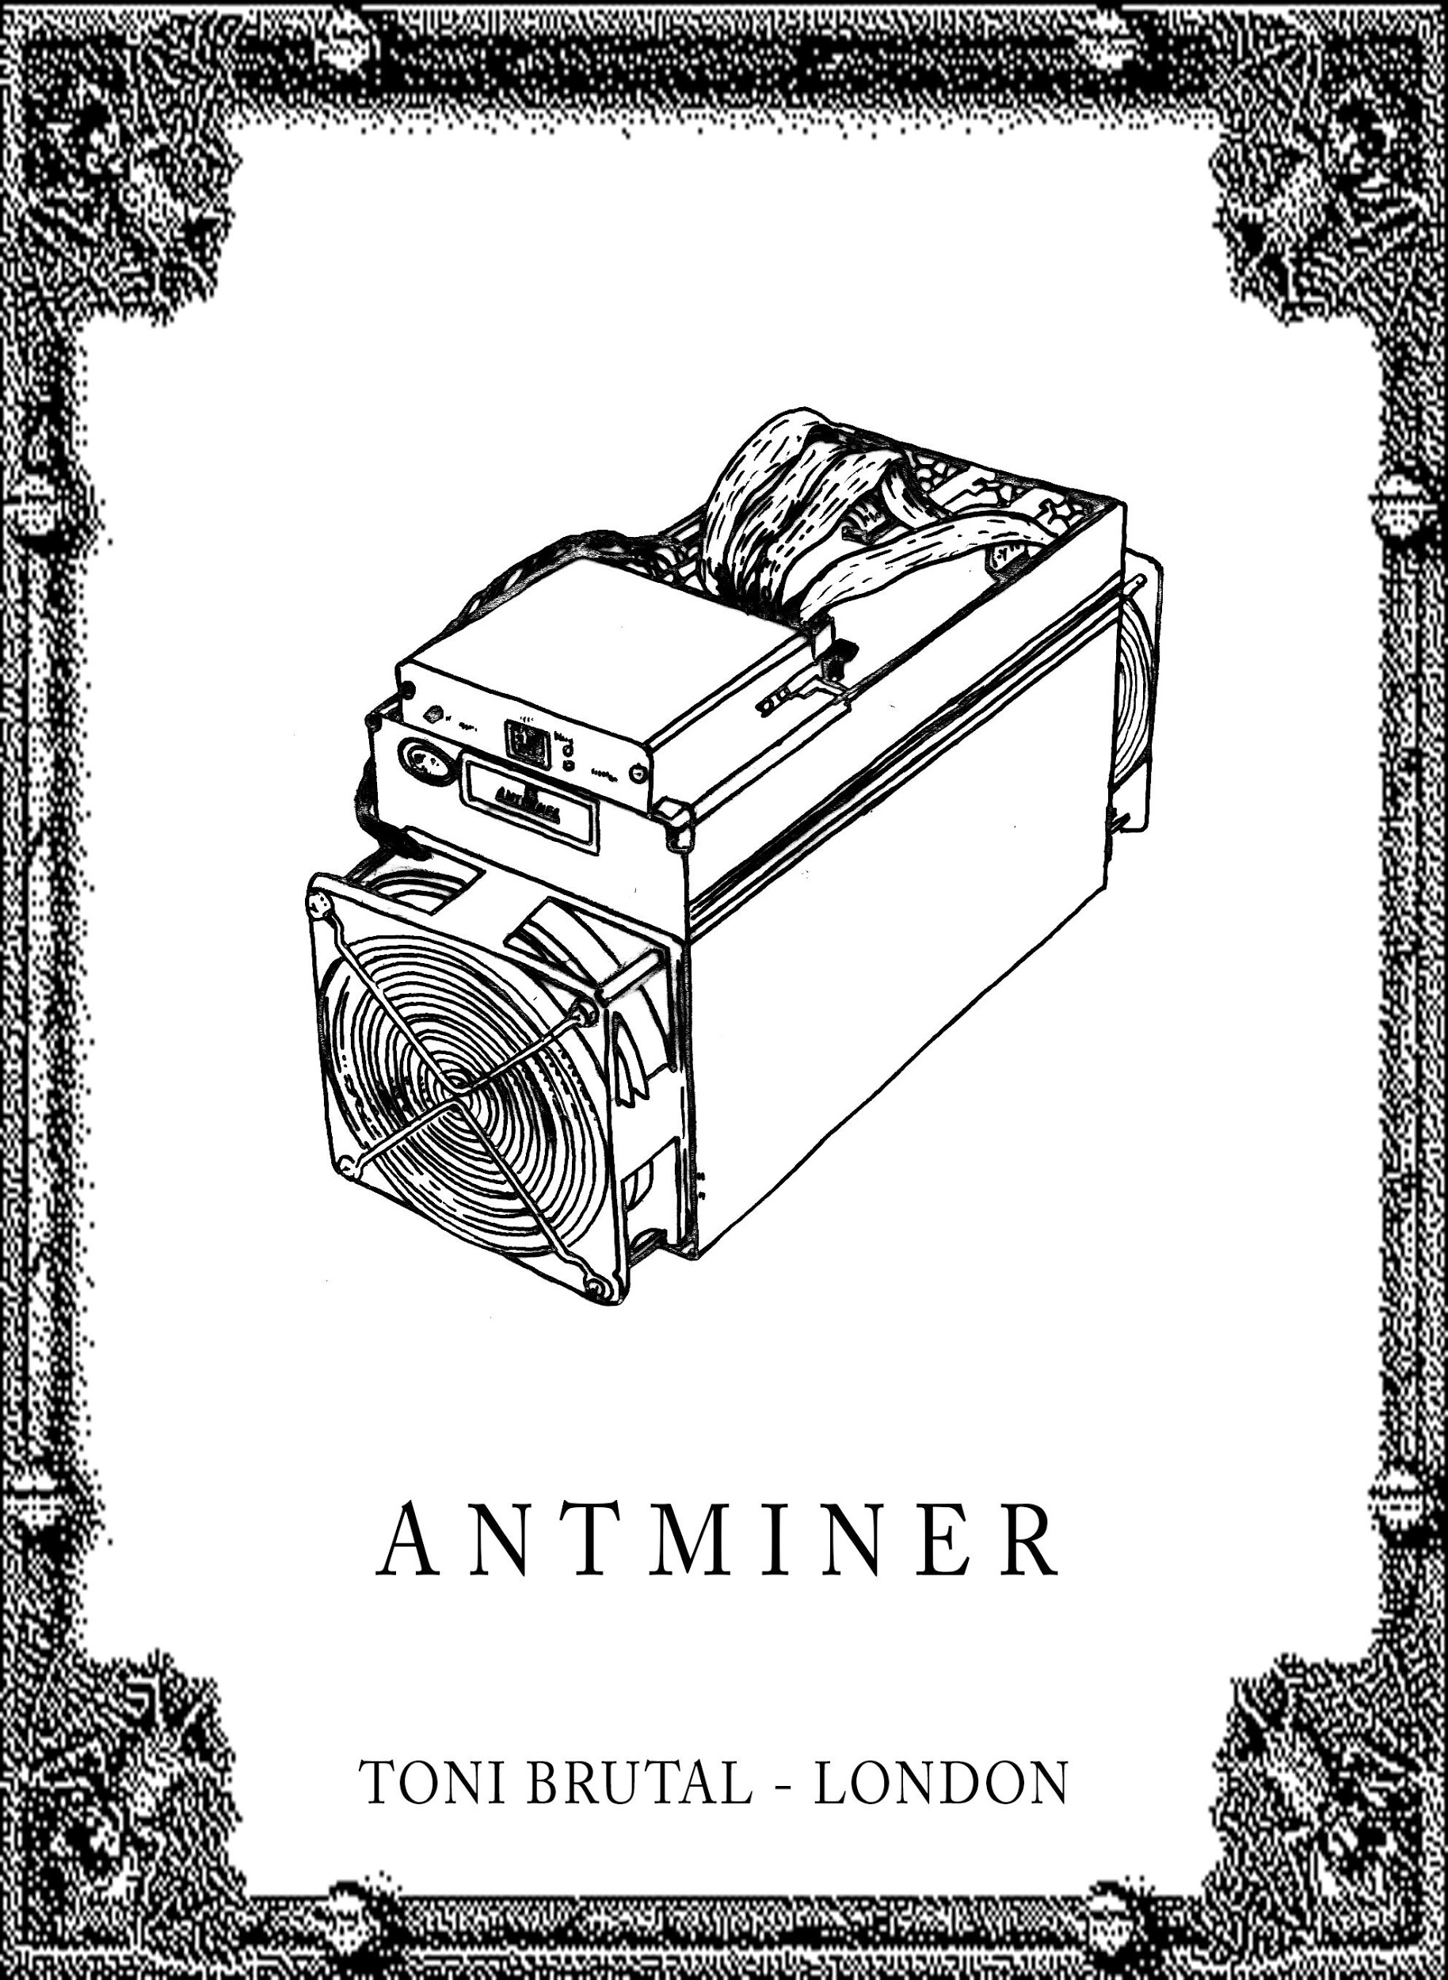
The idea
Ethernaal Artist create flashes, which are manual draw drafted over a piece of transparent paper sheet.
The Flash is then digitalized and turned into a single unique NFT, redeemable against the tattoo and/or the original flash.
The price of the tattoo and it´s consumable are included in the NFT.
Orginal flash - tonibrutal
Ethernaal NFT Tattoo
Ethernaal.com

Slide 5
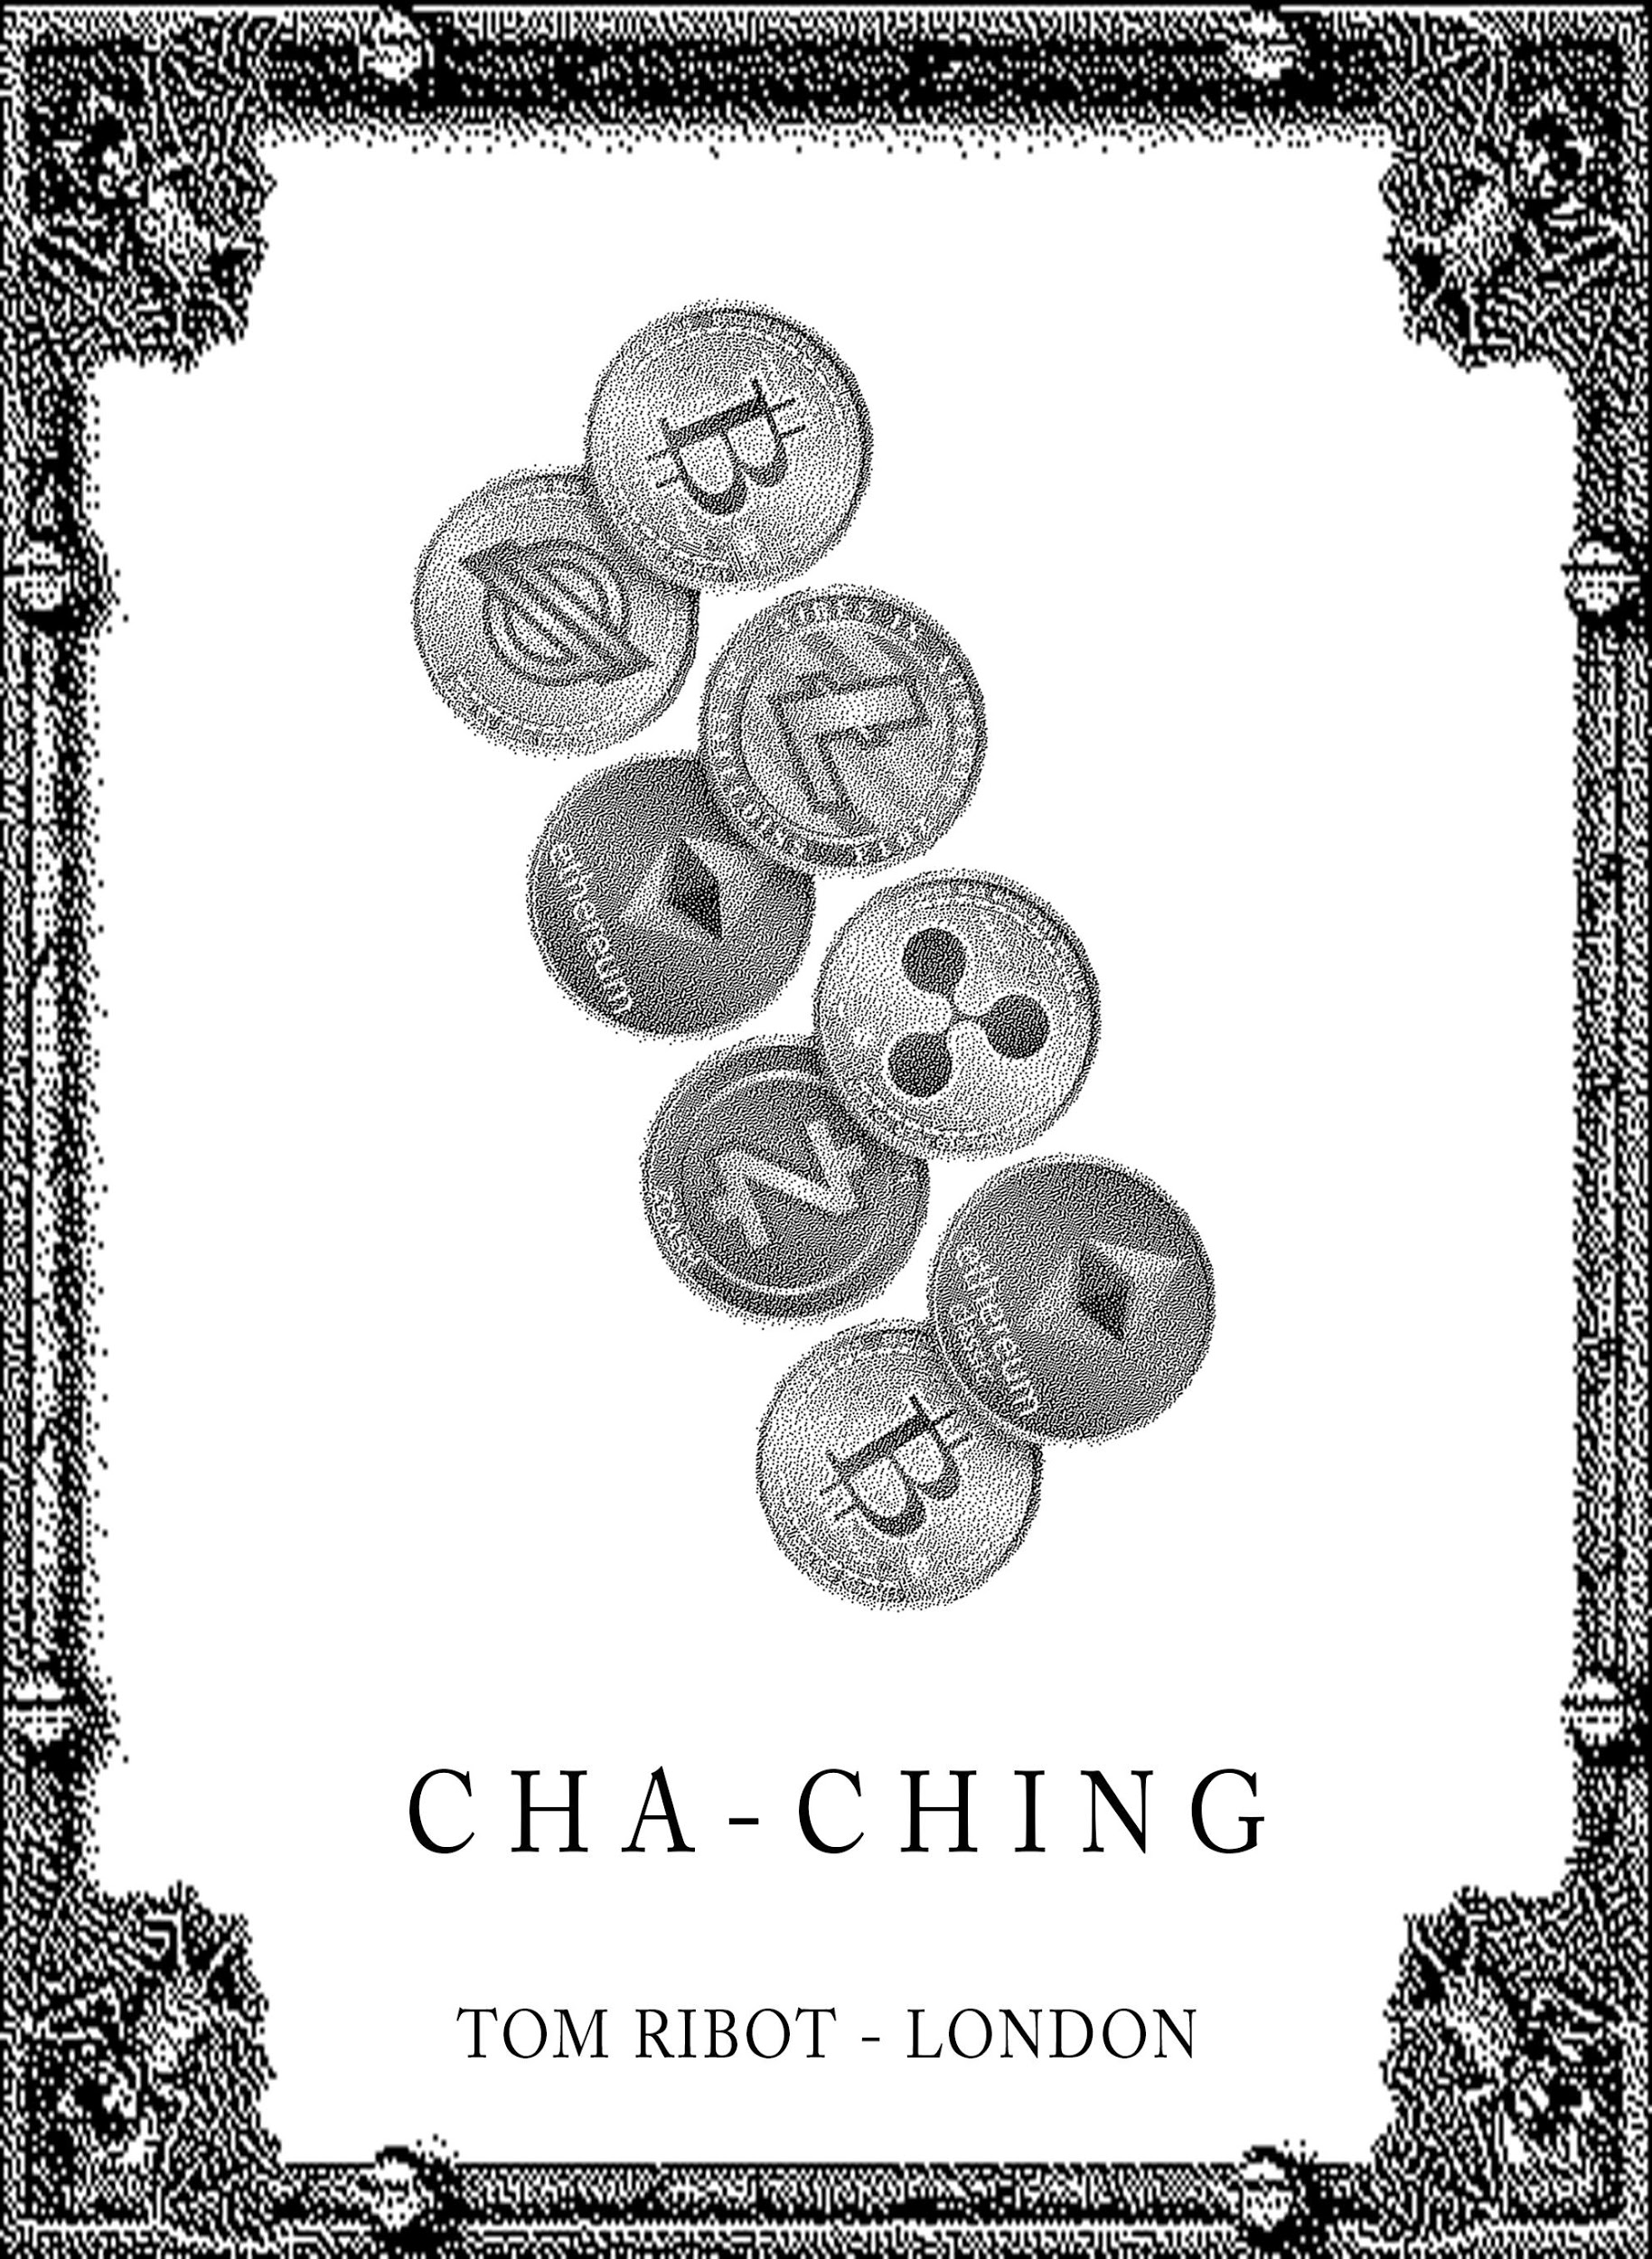
The idea
Ethernaal aims to be a collective platform around which the tattoo industry can evolve in the digital world, it aims to leverage Decentralized protocol to generate income, handle it´s own treasury and acquire digital art from other artists to build the Ethernaal Digital Art Museum.
Artists onboarded are free to mint non-redeemable NFT art (not binding to a tattoo) which are called “limited editions”.
In order to participate in governance, decision making on artist onboarding, ethical censorship, to book a session with a tattoo artist or to submit a custom design request the $NAAL governance token is required.
Ethernaal.com

Slide 6
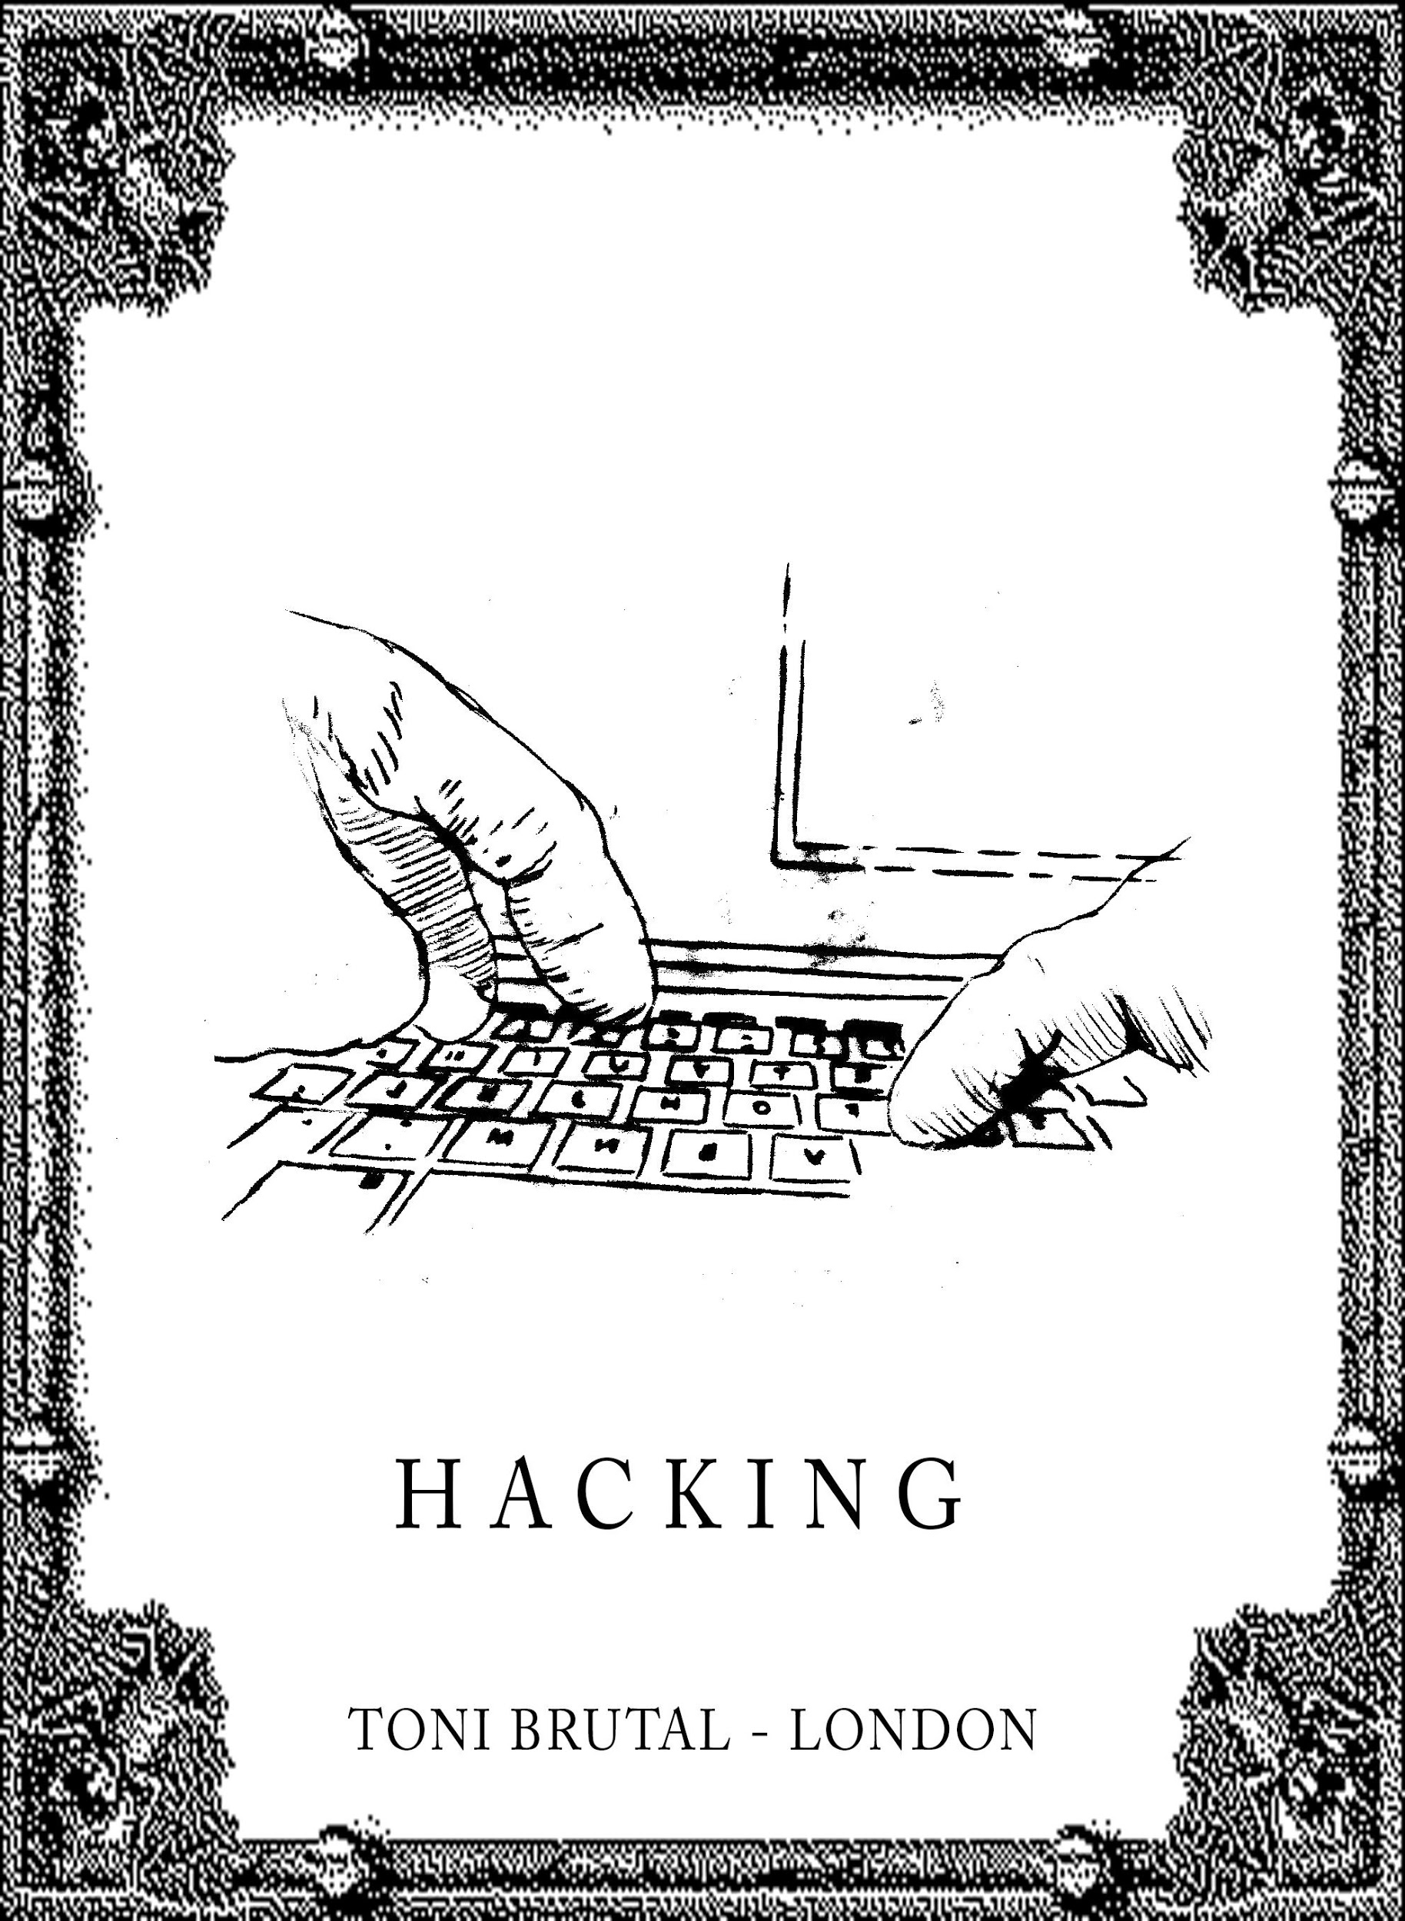
Ethernaal offers tattoo artists a door to enter the digital art world by leveraging a combination of decentralized applications and protocols wrapped around the tattoo industry, it offers:
Tattoo
NFT
DeFi
Museum
Art
index
DAO

Slide 7
Decentralized Applications:
RARIBLE
MINTBASE
PINATA
NFT Minting
NFT Minting
USECASE
Over 100 NFTs (ERC721 & ERC1155) minted for Ethernaal during the hackaton.
Integrated NFT minting module with Ethernaal.
Use of `EXCHANGE` APIs to create & retrieve orders
Contract:
0x509fd4cdaa29be7b1fad251d8ea0fca2ca91eb60
Minting of tatoo NFT design and building Ethernaal store.
Store URL:
https://rinkeby.mintbase.io/minter/0x74d5a467cf645e5d22d4e7fa2a73a88a9c56ed1d/0xa873bb96597d71d3ba6764ab26387db598f65372
Used for decentralizing the storage of both our images as well as metadata, we used Pinata for pinning them. We send the created images and metadata to pin at Pinata and retrieve it while minting.
URL:
https://gateway.pinata.cloud/ipfs/QmXaoSUyW1TdNEEkusKZnnML1DueEQTWttKG4VbFokebu4
Ethernaal.com

Slide 8
Decentralized Applications:
ARAGON
UNISWAP
NFTX
DAO & TOKEN
Liquidity Pool
Ethernaal Indexes
Central place for Governance, finances and operations management.
Governance token: NAAL
URL:
https://rinkeby.client.aragon.org/#/ethernaal/
Token contract (NAAL): 0x946d9f6e682ef604d2b5f04d1348db7b24022d7f
Leveraged to create liquidity pool for ERC20 shares token generated in NFTFY.
Contract (Rinkeby):
0x11206a1fd0a6eabf21035dfc24801940e5a139dc
Leveraged to create indexes on Ethernaal artists, style and categories.
Contract:
N/A – Impossible to deploy a gallery during the hackaton request form for gallery sent but no answer from team request
Ethernaal.com

Slide 9
Decentralized Applications:
ReactJS
ENS
NFTFY
Fronted
Artist Block ID
ERC20 Shares Token
Integration of web3 technology to connect user wallet. Upload metadata to ipfs and Interaction with Rarible Contract.
Tatto Artist block id card, allow buyer to contact and locate the artist for NFT redemption
ENS (Main net):
ethernaal.eth
tonibrutal.eth ENS (Rinkeby) configured: ethernaal.eth
Leveraged to create ERC20 shares token of tattoos NFT own by the community (DAO) which are turn supplied into DEX´s liquidity pools to create additional passive revenue.
Contract:
0x0b6a13057a9466ea755e1b62599f9909c6a2a072
Ethernaal.com

Slide 10
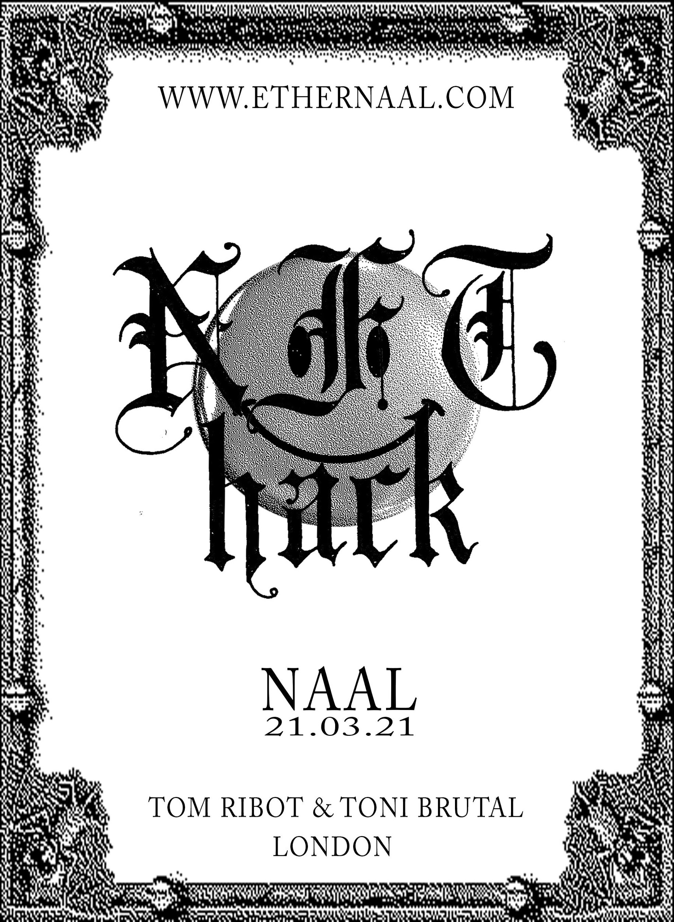
A token of Gratitude:
A small gesture to demonstrate our gratitude, The team met in the hackaton team building call and as already decided to bring this project and community to life.
We will airdrop to all hackaton participants the first Ethernaal mainet NFT (non-redeemable), a limited edition made by our tattoo artist for the hackaton.
$NAAL is the celting word for birth.
Ethernaal.com

Slide 11
Resources:
Github: https://github.com/Ethernaal
Demo Front-end: https://elastic-edison-785be1.netlify.app
Web: Ethernaal.com
Video Demo: See github
Ethernaal.com

Slide 12
Rinkeby Contract and tx:
ITEM | DESCRIPTION | CONTRACT | TOKEN | URL | COMMENT JULIEN
NFTFY - NFT52 | ETHEREUM NFT | 0x5b6273afeef88d9c228e6c102aad0e4168e37767 | RARI52 | https://app.nftfy.org/contract/detail/0x5B6273afeEf88D9C228e6c102aaD0e4168E37767 | To create design and integrates
NFTFY - NFT55 | ANTMINER NFT | 0xa78b117f57f13d53761098cd7c9524a1e82a4265 | RARI55 | https://app.nftfy.org/contract/detail/0xa78b117f57f13d53761098cd7c9524a1e82a4265
NFTFY - NFT50 | NFT HACK NFT | 0x0b6a13057a9466ea755e1b62599f9909c6a2a072 | RARI50 | https://app.nftfy.org/contract/detail/0x0b6a13057a9466ea755e1b62599f9909c6a2a072
NFTY - NFT54 | HACKING NFT | 0xaa4682ae22d1e3bdd7b4cb6db0c6c24cb12f7506 | RARI54 | https://app.nftfy.org/contract/detail/0xaa4682ae22d1e3bdd7b4cb6db0c6c24cb12f7506
NFTFY - NFT53 | NETWORK NFT | 0xd919d81e010a7d5ff9971cbbfcba6d54940a4484 | RARI53 | https://app.nftfy.org/contract/detail/0xd919d81e010a7d5ff9971cbbfcba6d54940a4484
NFTFY - NFT51 | CPU RENDER NFT | 0x6a972cdcc6b62690054e32f5250fee8d490a8541 | RARI51 | https://app.nftfy.org/contract/detail/0x6a972cdcc6b62690054e32f5250fee8d490a8541
UNISWAP LP | RARI50/ETH LP | 0x11206a1fd0a6eabf21035dfc24801940e5a139dc |  | https://info.uniswap.org/token/0x0b6a13057a9466ea755e1b62599f9909c6a2a072 | We can integrate uniswap LP Stats page into our webapp
SUSHI LP | RARI52/ETH LP | 0xed28c15c4b6192d74e65f6e95236863c6037fd53 |  | https://analytics.sushi.com/tokens/0x5B6273afeEf88D9C228e6c102aaD0e4168E37767 | We can skip integration for now if no answer from 0xMaki - leave something like " SushiSwap - Coming Soon"
NAAL | GOV. TOKEN | 0x946d9f6e682ef604d2b5f04d1348db7b24022d7f | NAAL
ARAGON | DAO GOV |  |  | https://rinkeby.client.aragon.org/#/ethernaal/
RARI52 | 0x509fd4cdaa29be7b1fad251d8ea0fca2ca91eb60
RARI55
RARI50
RARI54
RARI53
RARI51
MINTBASE | GALLERY / MARKET |  |  | https://rinkeby.mintbase.io/minter/0x74d5a467cf645e5d22d4e7fa2a73a88a9c56ed1d/0xa873bb96597d71d3ba6764ab26387db598f65372
PINATA | STORAGE |  |  | https://gateway.pinata.cloud/ipfs/QmXaoSUyW1TdNEEkusKZnnML1DueEQTWttKG4VbFokebu4
Ethernaal.com

Slide 13
Rinkeby Integrations
Ethernaal.com

Slide 14
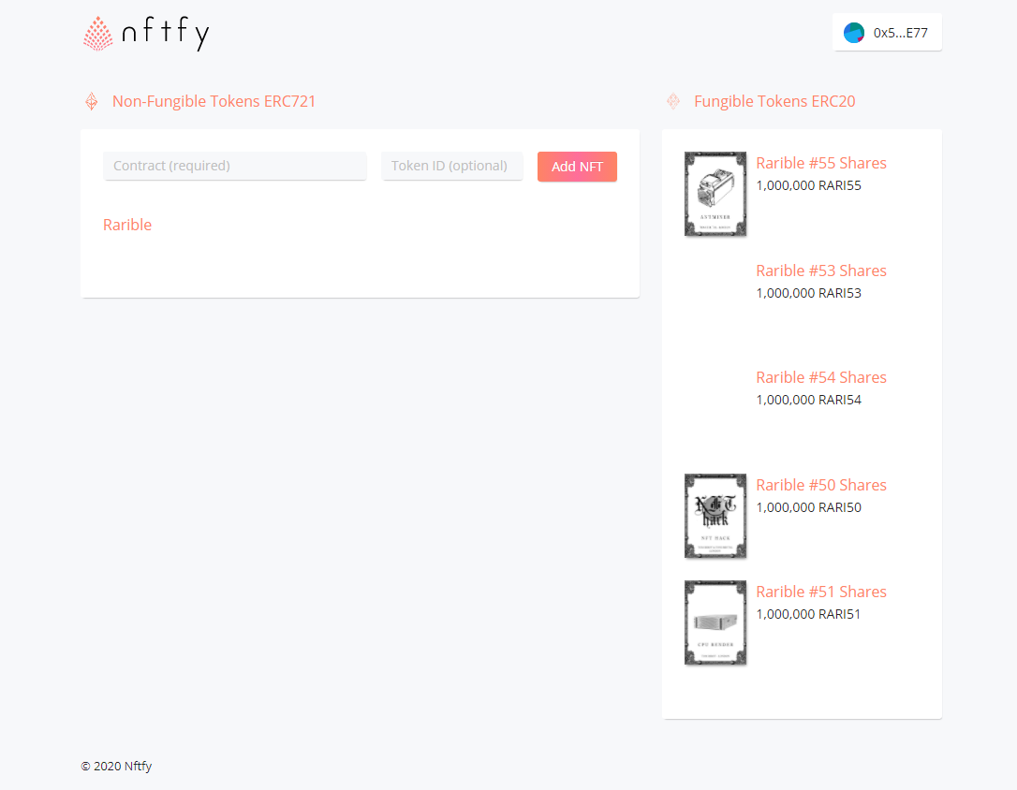
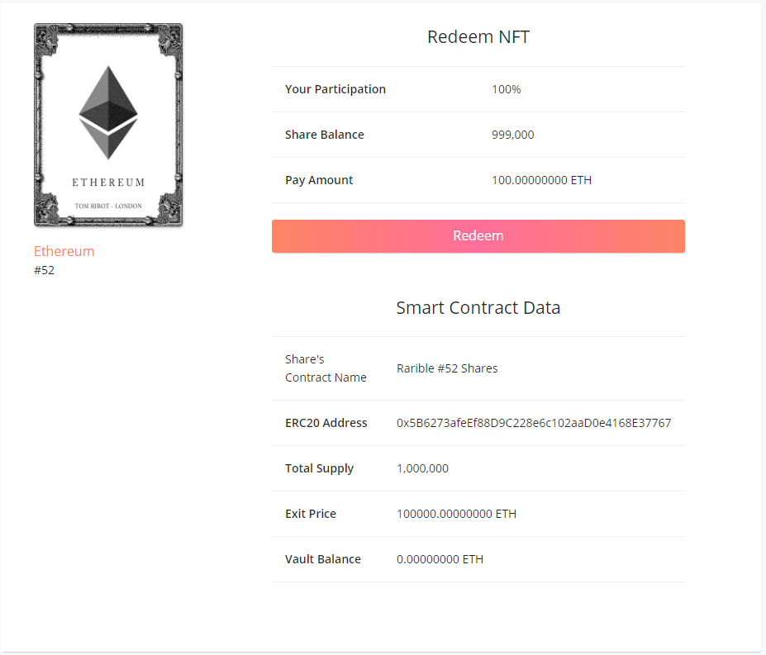
NFTFY
Ethernaal.com

Slide 15
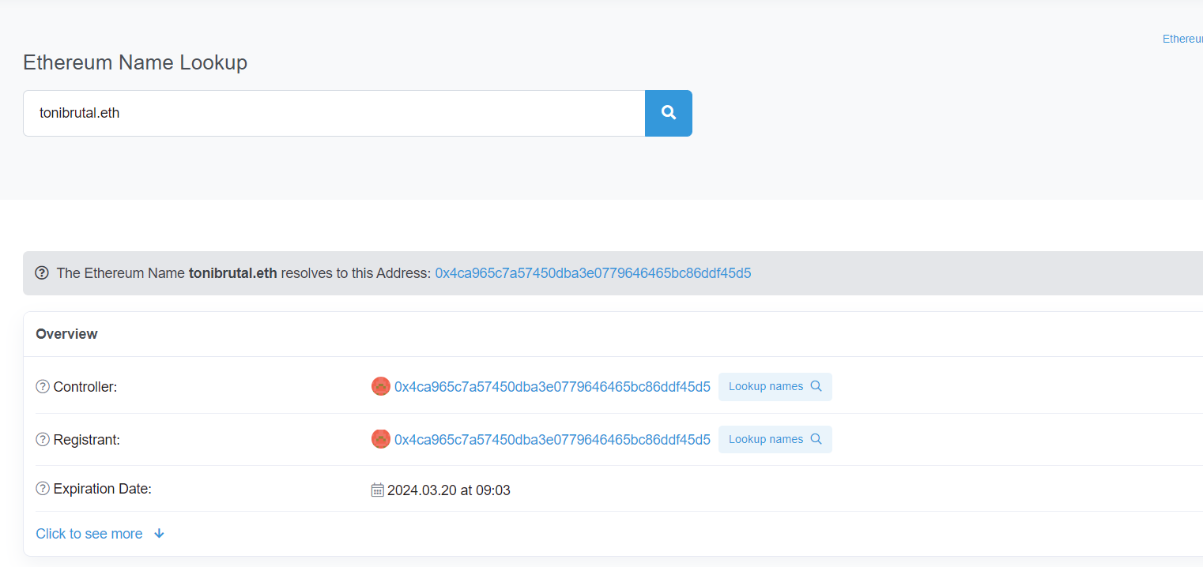
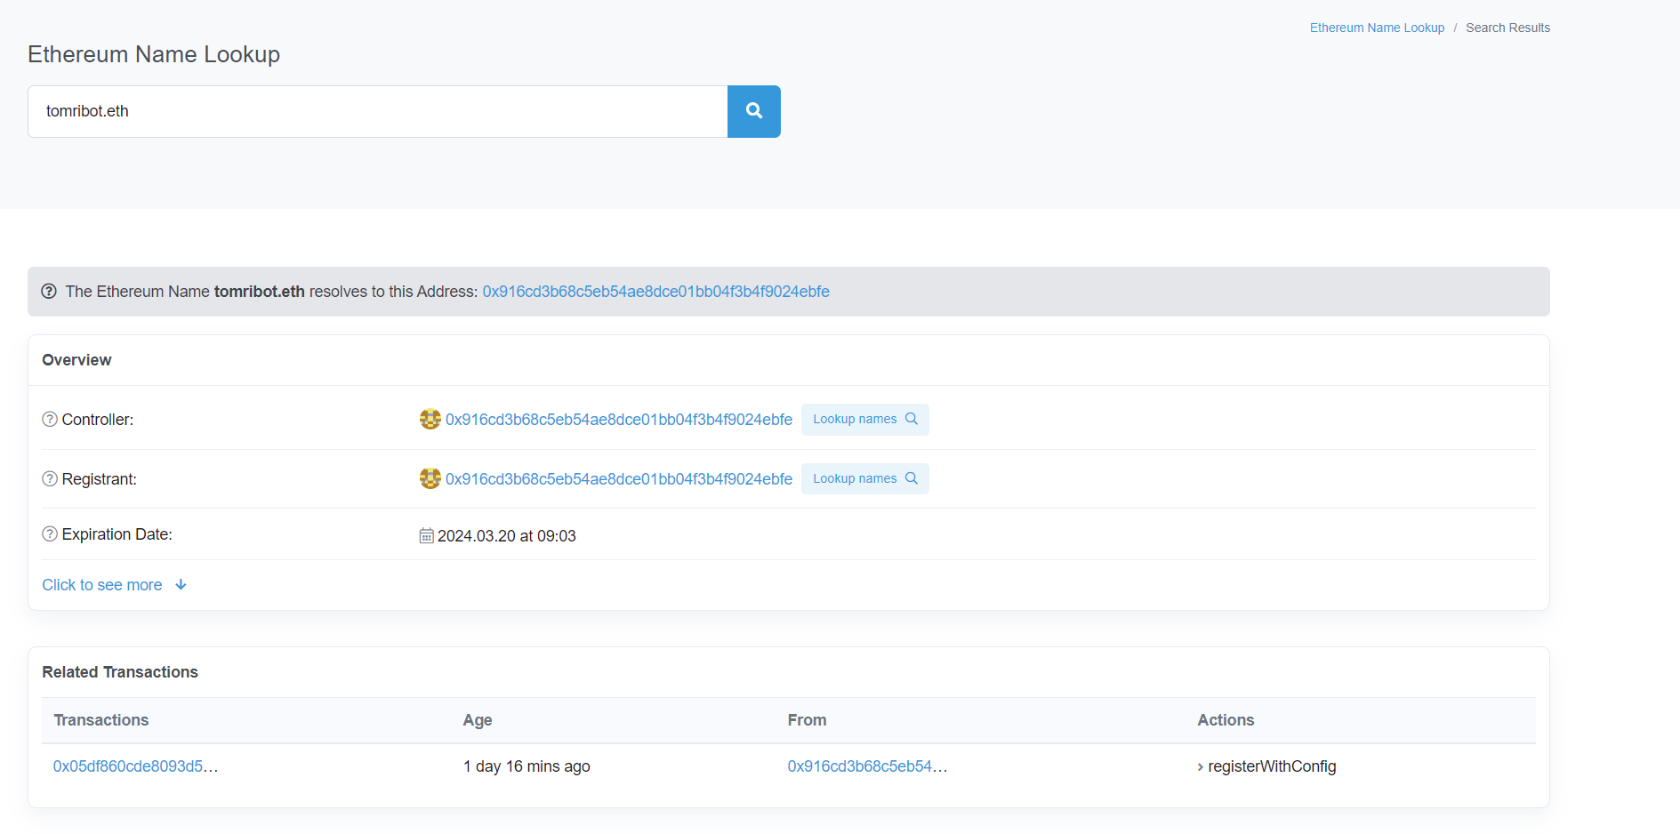
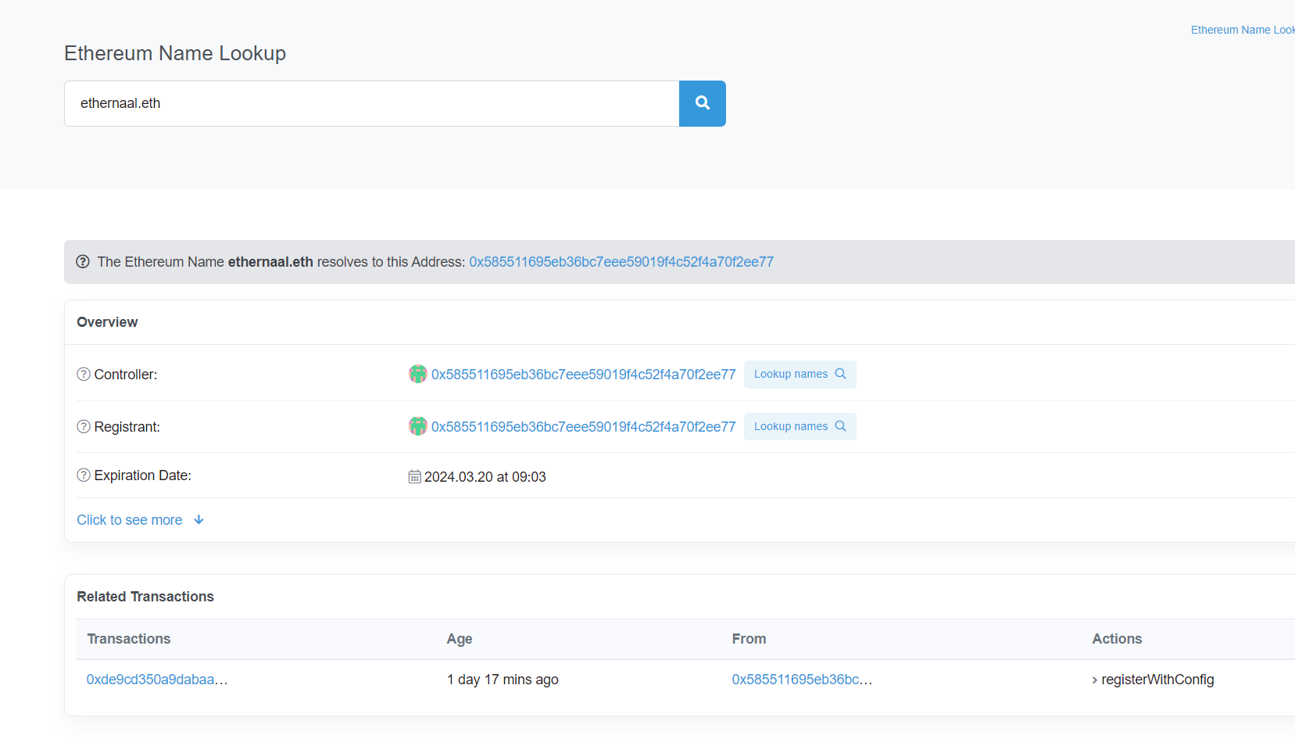
ENS (main)
Ethernaal.com

Slide 16
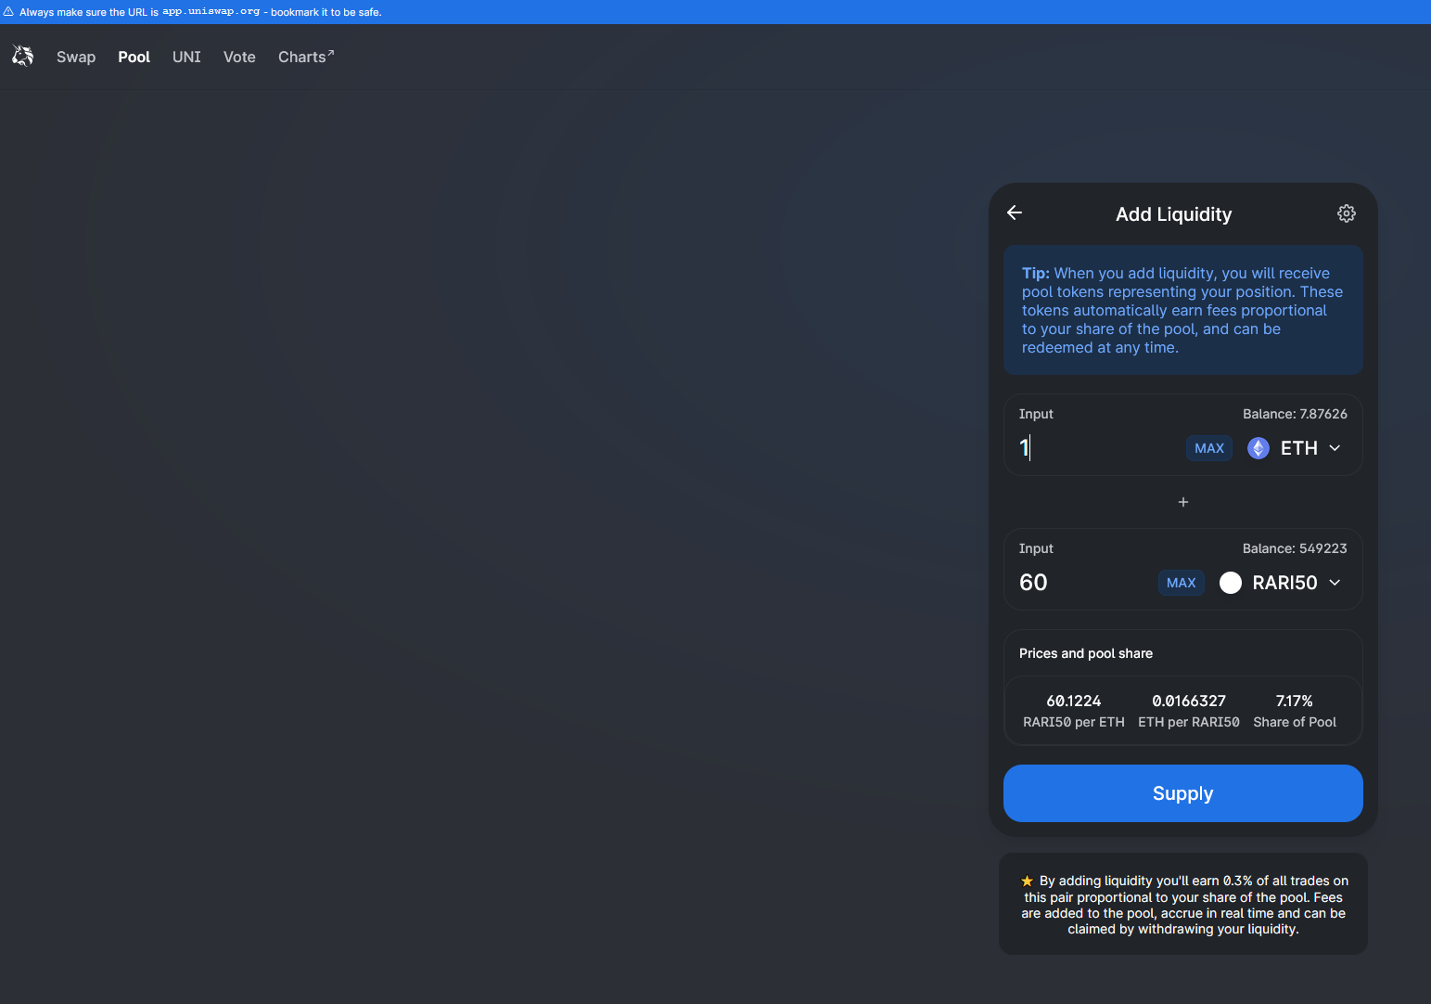
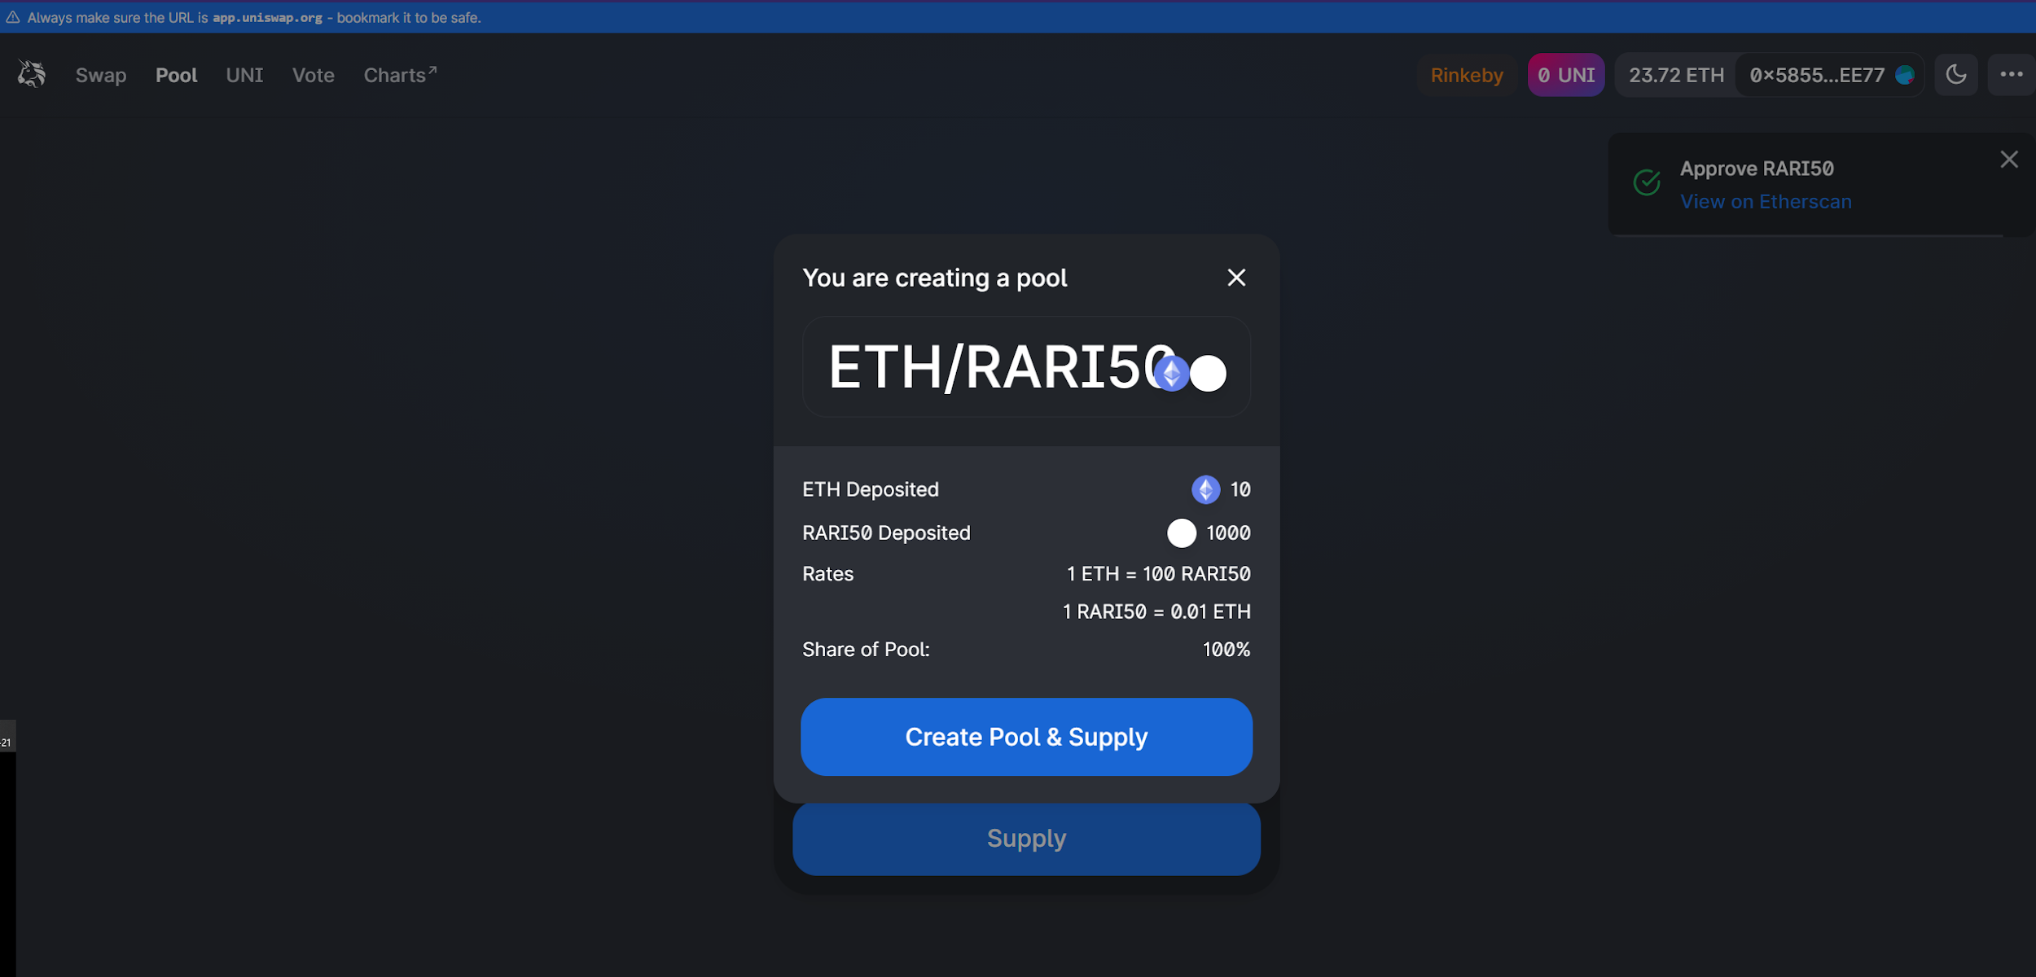
UNISWAP
Ethernaal.com

Slide 17
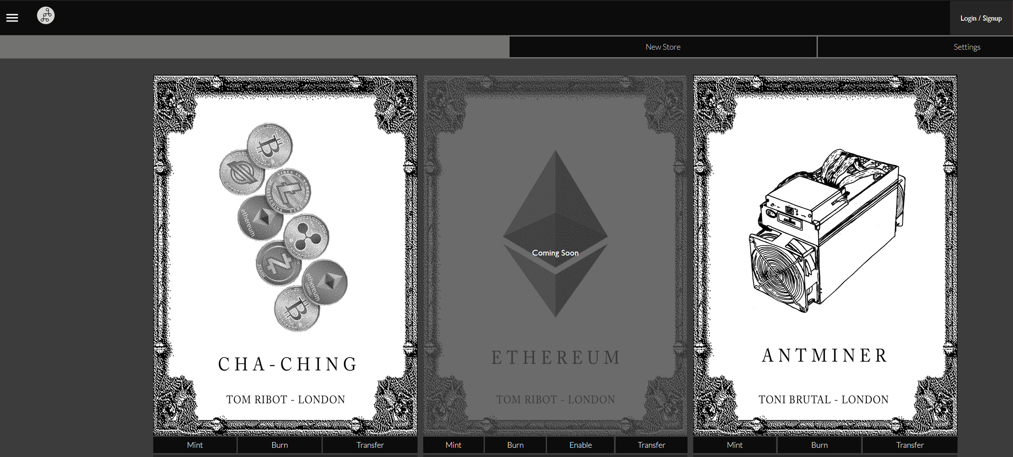
MINTBASE
Ethernaal.com

Slide 18
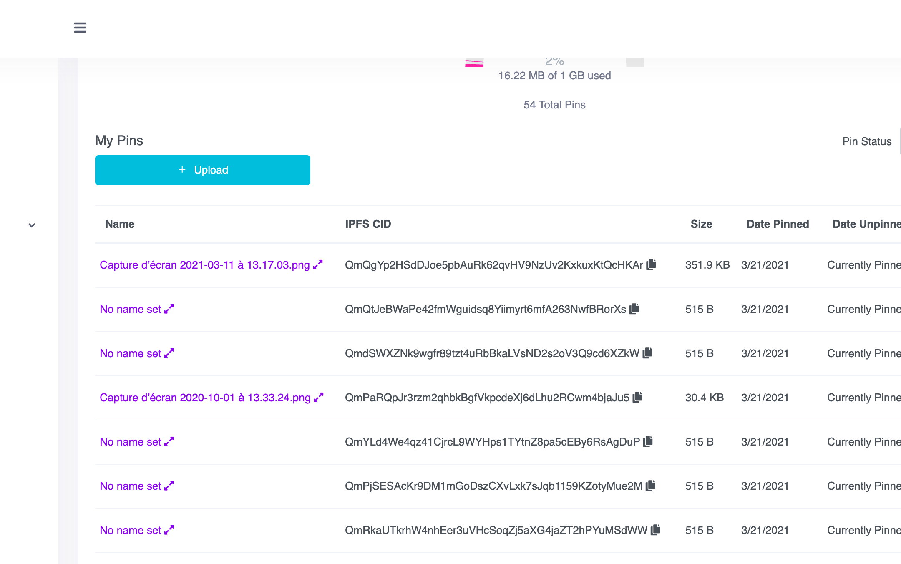
PINATA
Ethernaal.com

Slide 19
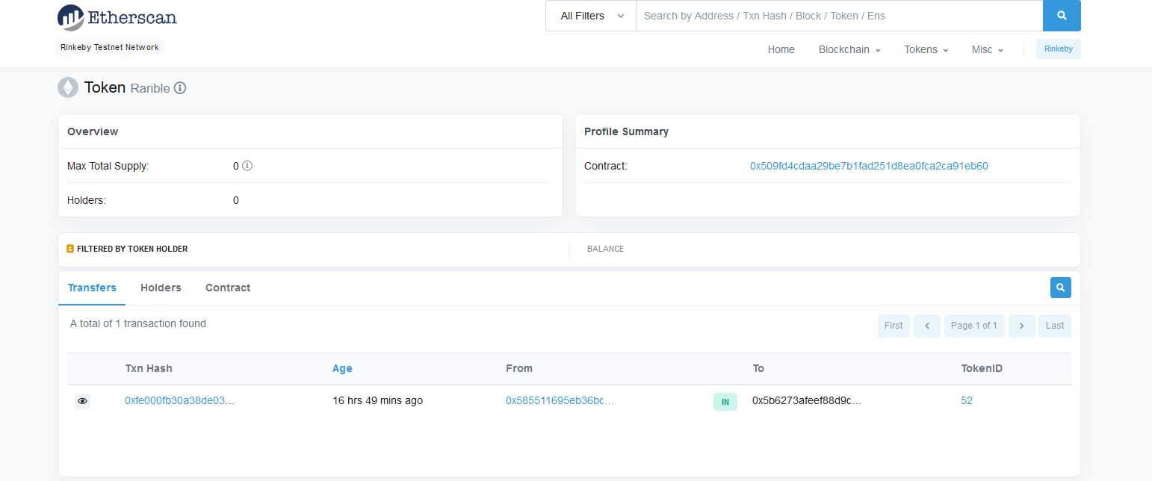
RARIBLE
Ethernaal.com

Slide 20
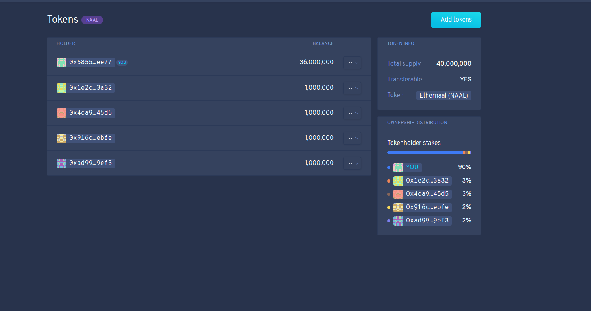
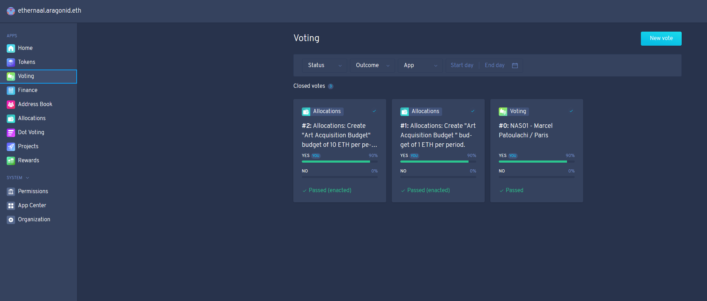
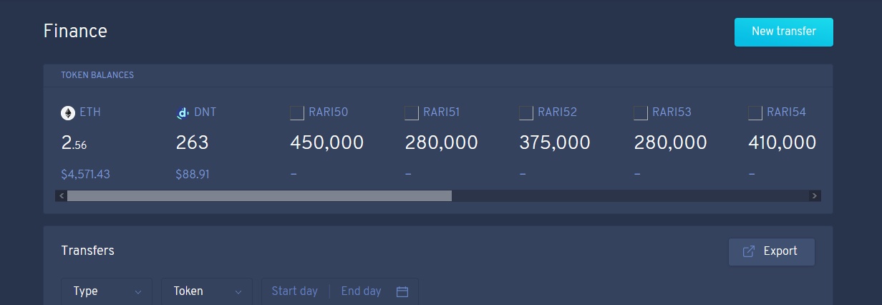
ARAGON DAO
Ethernaal.com

Slide 21
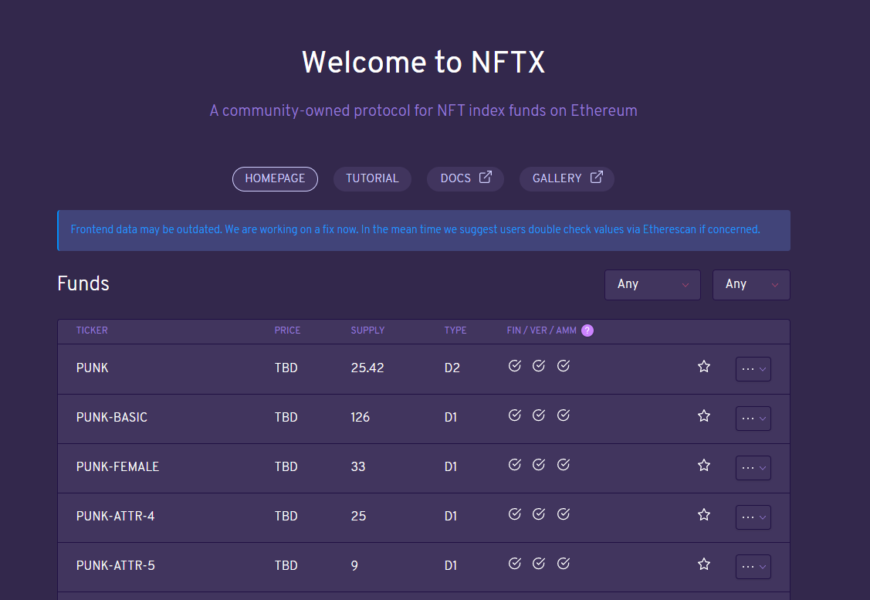
NFTX
NFTX Integration could not be achieved
within the allocated deadline.
Ethernaal.com

